Slide 1
CS 2200
LAB 6

Slide 2
Brief Overview:
Pipelining, Data Hazards,
Control Hazards

Slide 3
Announcements
Homework 5 will be released tonight and will be due February 28th @ 6:15 PM
Project 2 is out and is due February 26th.

Slide 4
Pipelines

Slide 5
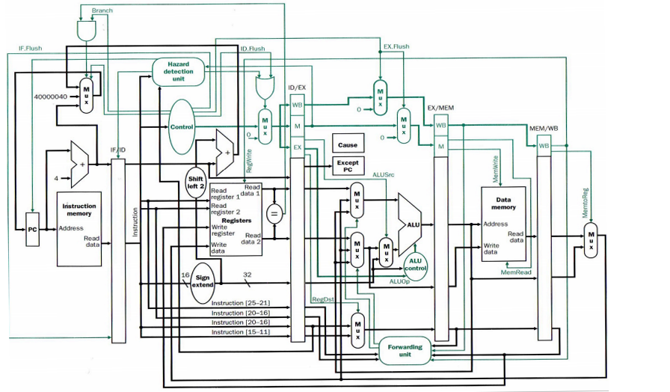
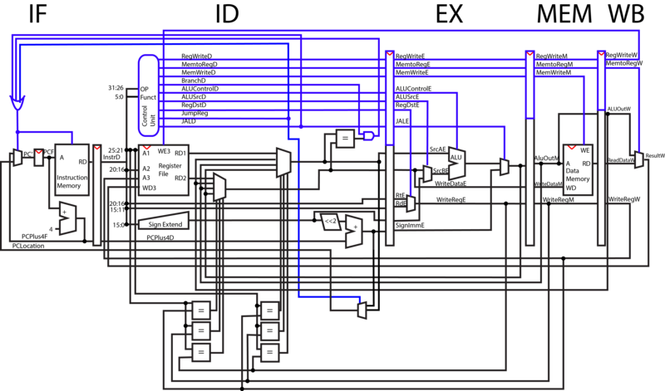
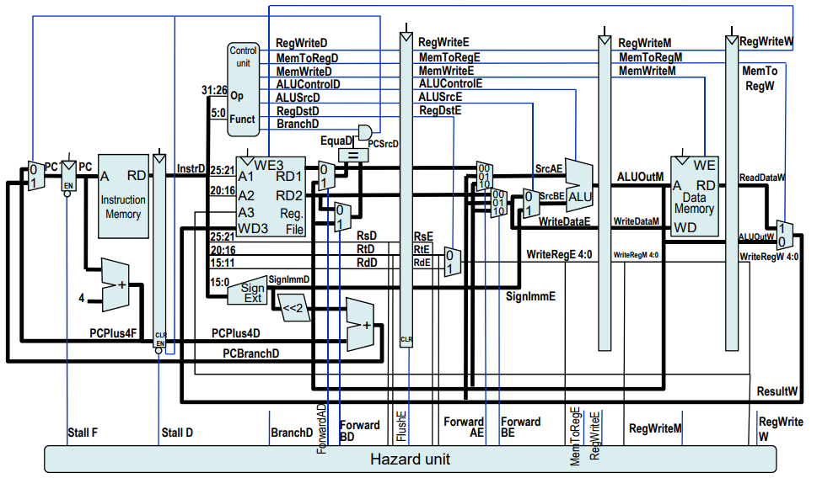
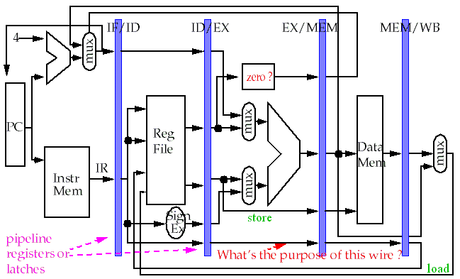
Pipelines are not scary!

Slide 6
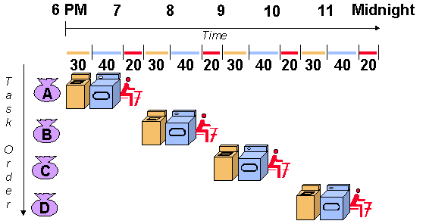
Exercise: Pipeline Analogy
Suppose you have 4 loads of laundry that you want to wash, but you only have one washer and one dryer with the following durations:
Washing - 30 min
Drying - 40 min
Folding - 20 min
Approach A runtime:
?

Slide 7
Solution: Pipeline Analogy
Suppose you have 4 loads of laundry that you want to wash, but you only have one washer and one dryer with the following durations:
Washing - 30 min
Drying - 40 min
Folding - 20 min
Approach A runtime:
(30 + 40 + 20) * 4 = 360 min

Slide 8
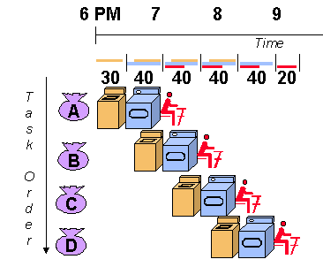
Pipeline Analogy
Suppose you have 4 loads of laundry that you want to wash, but you only have one washer and one dryer with the following durations:
Washing - 30 min
Drying - 40 min
Folding - 20 min
Approach B runtime:
?

Slide 9
Pipeline Analogy
Suppose you have 4 loads of laundry that you want to wash, but you only have one washer and one dryer with the following durations:
Washing - 30 min
Drying - 40 min
Folding - 20 min
Approach B runtime:
30 + 40 + 20 + (40 * 3) = 210 min

Slide 10
5 Stage Pipeline
Separate the CPU into different function units that all have a unique function.
Fetch instructions from instruction memory
Read registers and decode the instruction
Execute the instruction or calculate an address
Read/store an operand in data memory
Write back the result into a register

Slide 11
Pipelining Buffers
For each bridge between stages, there exists a single buffer that is able to store the intermediate data required for each stage, and pass it on where it is needed.
When breaking the processor down into multiple sections, there needs to be a way to temporarily hold data between clock cycles.
This data needs to be buffered such that it is used in the next stage.

Slide 12
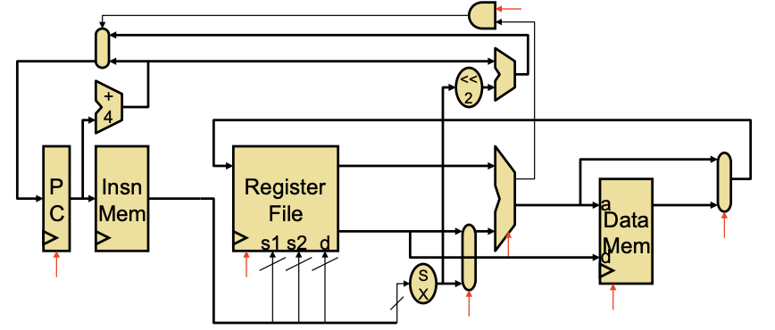
Single Cycle Pipeline

Slide 13
Single Cycle Pipeline
Mux to select PC+4 or PC+4+offset
Control logic using ALUOut
Incrementing PC by 4 bytes
sext. offset *= 4 when adding to PC+4
DPRF: 2R or 1W
Select ALUOut or MemOut to write back to RegFile
Separate memory access for instructions
Main ALU
Sign ext. offset

Slide 14
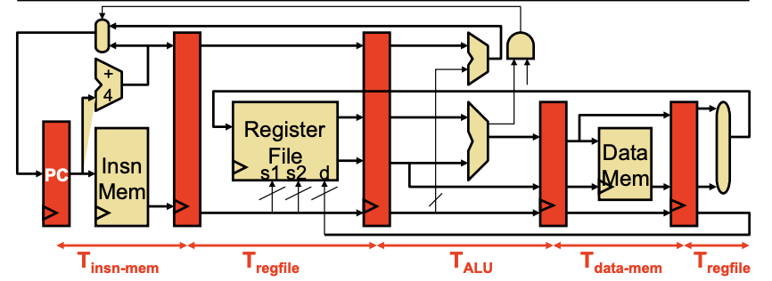
5 Stage Pipeline

Slide 15
Determining Buffer Size

Slide 16
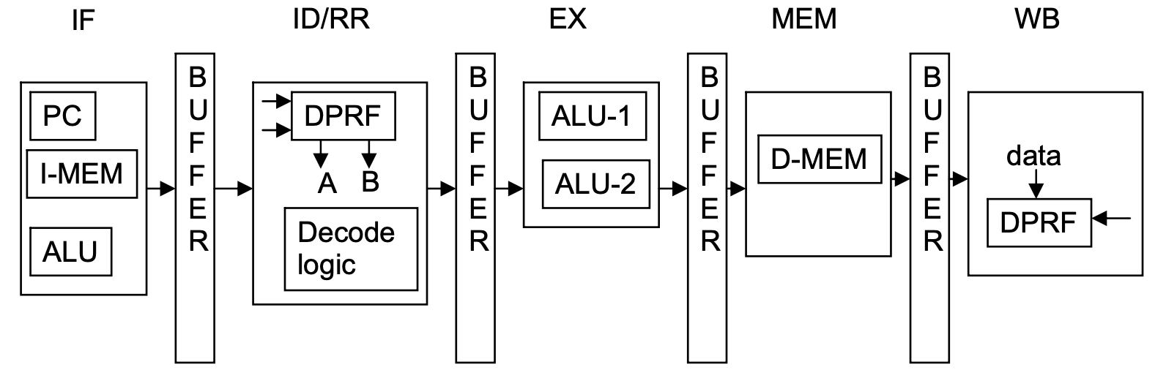
Decode Buffer Example
To calculate the size of the buffer DBUF that is required for the decode stage, we need to list all the bits that are needed to be passed down the pipeline for each stage and then take the union of this information.
ADD, NAND, ADDI, LW, SW, BEQ, JALR, HALT

Slide 17
Exercise: Decode Buffer
What bits need to be included in the Decode Buffer to handle all of the below instructions?
ADD: opcode, Rx, A, B
NAND: opcode, Rx, A, B
ADDI: opcode, Rx, A, imm
LW: opcode, Rx, imm, A
SW: opcode, B, imm, A
BEQ: opcode, A, B, imm, PC
JALR: opcode, Rx, B, PC
HALT: opcode

Slide 18
Decode Buffer Example
Note: We do not overload the buffer registers in this example!
Decode Buffer - { opcode, Rx, A, B, imm, PC }

Slide 19
Hazards

Slide 20
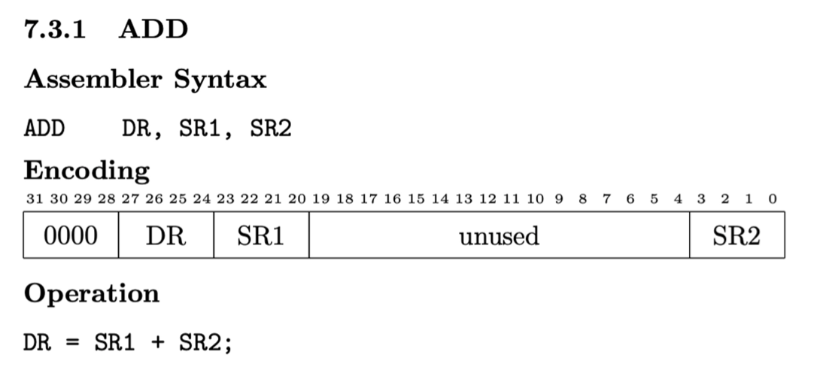
Why do we have hazards?
Some combinations of instructions can create problems/delays in our processor that can lead to incorrect execution.
To avoid hazards, sometimes we must make our pipeline less efficient
Ideally, we don’t want to HALT and flush every instruction out of the pipeline
We use a NOP instruction as a “bubble”:
NOP - 00000000000000000000000000000000
Same as (ADD $zero, $zero, $zero)

Slide 21
Structural Hazards
Occur due to a lack of hardware components
If we lack the hardware to do multiple similar operations simultaneously, we must create “bubbles” in the processor until that resource is free
Example: needing 2 ALUs for branching (BEQ, BGT)

Slide 22
Control Hazards
Occur as a result of instructions executing non-sequentially.
Ex: We use a BEQ instruction, changing the value of the PC, but have already pushed instructions into the pipeline assuming the branch wasn’t taken.
Solution: Flush instructions out of the pipeline if we are wrong about a branch being taken/not taken.

Slide 23
Data Hazards
Occur when data is changed in one stage of the pipeline, potentially affecting instructions in other stages.
3 kinds:
Read After Write (RAW)
Write After Read (WAR)
Write After Write (WAW)
Question: Which kind of data hazard is most likely to occur in our 5-stage pipeline?

Slide 24
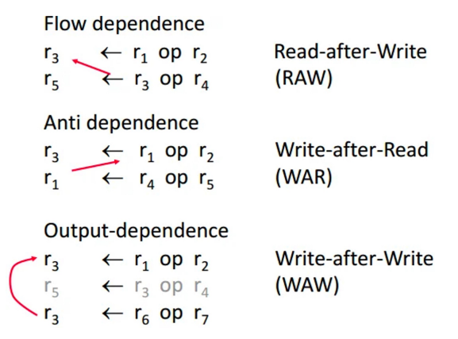
RAW, WAR, WAW Dependency

Slide 25
Exercise: Data Hazard Identification
I1: LEA $t0, label
I2: NAND $a0, $t0, $a0
I3: ADD $t0, $zero, $t2
I4: SW $a0, 0($t1)
I5: ADD $t2, $a0, $t0
Identify all the hazards in the example above, (RAW, WAR, WAW) and fill out the table below, with each cell representing a dependency between two instructions. The Xs below mark redundant square, so there is no need to fill them in. For any pair of instructions that do not have any dependence, denote this using a dashed line – .

Slide 26
HAZARD | I1 | I2 | I3 | I4 | I5
I1 | X | X | X | X | X
I2 |  | X | X | X | X
I3 |  |  | X | X | X
I4 |  |  |  | X | X
I5 |  |  |  |  | X

Slide 27
HAZARD | I1 | I2 | I3 | I4 | I5
I1 | X | X | X | X | X
I2 | RAW | X | X | X | X
I3 | WAW | WAR | X | X | X
I4 | - | RAW | - | X | X
I5 | - | RAW | RAW, WAR | - | X

Slide 28
Visualizing Data Hazards
Assume $t0 is 0:
i1: ADDI $t0, $zero, 1
i2: ADDI $t0, $t0, 2
…
i5: ADD $t1, $t0, $t0

Slide 29
Visualizing Data Hazards
Assume $t0 is 0:
i1: ADDI $t0, $zero, 1
i2: ADDI $t0, $t0, 2
…
i5: ADD $t1, $t0, $t0
i1
Reads: $zero = 0
imm = 1

Slide 30

Visualizing Data Hazards
Assume $t0 is 0:
i1: ADDI $t0, $zero, 1
i2: ADDI $t0, $t0, 2
…
i5: ADD $t1, $t0, $t0
i2
Reads: $t0 = 0
imm = 2
i1
Calc $t0 = 1

Slide 31
Visualizing Data Hazards
Assume $t0 is 0:
i1: ADDI $t0, $zero, 1
i2: ADDI $t0, $t0, 2
…
i5: ADD $t1, $t0, $t0
i3
…
i2
Calc $t0 = 2
i1

Slide 32
Visualizing Data Hazards
Assume $t0 is 0:
i1: ADDI $t0, $zero, 1
i2: ADDI $t0, $t0, 2
…
i5: ADD $t1, $t0, $t0
i4
…
i3
…
i2
i1
Writes $t0 = 1

Slide 33
Visualizing Data Hazards
Assume $t0 is 0:
i1: ADDI $t0, $zero, 1
i2: ADDI $t0, $t0, 2
…
i5: ADD $t1, $t0, $t0
i5 finally reads i1’s $t0 NOT i2’s $t0
i5
Reads $t0 = 1
i4
…
i3
…
i2
Writes $t0 = 2

Slide 34
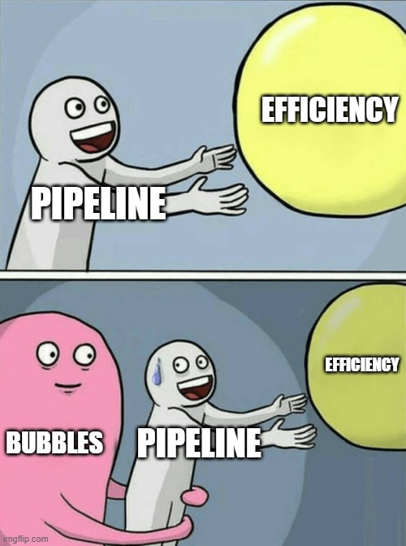
Notes:
Bad for CPU efficiency. Why?

Slide 35
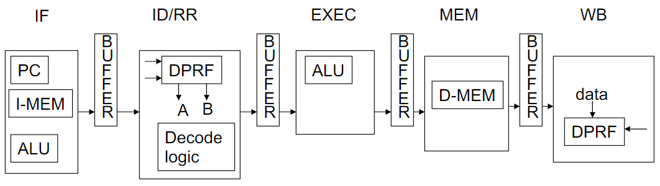
Exercise: Result of a Data Hazard
DPRF
Values
r1 | 1
r2 | 4
r3 | 3
Let’s say I want to take the value in r2 (4)
Add 3 to it
Add 5 to previous sum
Store result in r3
Result should be 4+3 = 7, then 7+5 = 12
i1: addi r1, r2, 3
i2: addi r3, r1, 5
What will the register values be if we don’t act on a data hazard between these two instructions?
Notes:
r2 is currently holding 4
values of r1 and r3 are random garbage values
Middleman r1

Slide 36
Cycle 1
DPRF
Values
r1 | 1
r2 | 4
r3 | 3
i1
IR: i1
i1: addi r1, r2, 3
i2: addi r3, r1, 5
i1 fetched at IF phase
i2 not yet in pipeline

Slide 37
Cycle 2
DPRF
Values
r1 | 1
r2 | 4
r3 | 3
i2
IR: i2
i1
OP: 2
Rx: 1
A: 4
imm: 3
i1: addi r1, r2, 3
i2: addi r3, r1, 5
i1 decoded at ID/RR phase
Register contents read: A=r2 imm=3
i2 fetched at IF phase

Slide 38
Cycle 3
DPRF
Values
r1 | 1
r2 | 4
r3 | 3
A:4, imm:3
A+imm
4+3=7
i3
.........
i2
OP: 2
Rx: 3
A: 1
imm: 5
i1
OP: 2
Rx: 1
Result: 7
i1: addi r1, r2, 3
i2: addi r3, r1, 5
i1 executed at EXEC phase: addi performed on ALU
Result calculated: result=r2+imm
i2 decoded at ID/RR phase
Register contents read: A=r1 imm=5
Notes:
Hint: something has gone wrong here

Slide 39
Cycle 4
DPRF
Values
r1 | 1
r2 | 4
r3 | 3
A:1, imm:5
A+imm
1+5=6
i4
.........
i3
.........
i2
OP: 2
Rx: 3
Result: 6
i1
OP: 2
Rx: 1
Result: 7
i1: addi r1, r2, 3
i2: addi r3, r1, 5
i1 at MEM phase: nothing happens
i2 executed at EXEC phase: addi performed on ALU
Result calculated: result=r1+imm

Slide 40
Cycle 5
DPRF
Values
r1 | 7
r2 | 4
r3 | 3
r1=Result
r1=7
i5
.........
i4
.........
i3
.........
i2
OP: 2
Rx: 3
Result: 6
i1
OP: 2
Rx: 1
Result: 7
i1: addi r1, r2, 3
i2: addi r3, r1, 5
i1 at WB phase: store result into register
DPRF update: r1=Result
i2 at MEM phase: nothing happens

Slide 41
Cycle 6
DPRF
Values
r1 | 7
r2 | 4
r3 | 6
r3=Result
r3=6
i6
.........
i5
.........
i4
.........
i3
.........
i2
OP: 2
Rx: 3
Result: 6
i1: addi r1, r2, 3
i2: addi r3, r1, 5
i1 is done: exits pipeline
i2 at WB phase: store result into register
DPRF update: r3=Result

Slide 42
Cycle 7
DPRF
Values
r1 | 7
r2 | 4
r3 | 6
i7
.........
i6
.........
i5
.........
i4
.........
i3
.........
i1: addi r1, r2, 3
i2: addi r3, r1, 5
i1 been done
i2 is done: exits pipeline

Slide 43
RESULTS
DPRF
Values
r1 | 7
r2 | 4
r3 | 6
i7
.........
i6
.........
i5
.........
i4
.........
i3
.........
NOT EQUAL!
Is r3 equal to our expected result 12?
NO!
What went wrong? Let’s look back to cycle 3
Notes:
Let’s look at cycle 3

Slide 44
Cycle 3
DPRF
Values
r1 | 1
r2 | 4
r3 | 3
A:4, imm:3
A+imm
4+3=7
i3
.........
i2
OP: 2
Rx: 3
A: 1
imm: 5
i1
OP: 2
Rx: 1
Result: 7
i1: addi r1, r2, 3
i2: addi r3, r1, 5
i2 decoded at ID/RR phase
Register contents read: A=r1 imm=5
r1 was supposed to be read as 7!
i3 calculated 7 at EXEC phase but registers aren’t updated until WB phase
i2 was not able to read the most updated correct value of r1
Notes:
r2 is currently holding 4
values of r1 and r3 do not matter

Slide 45
HAZARD!
This is a RAW data hazard! Where?
i1: addi r1, r2, 3
i2: addi r3, r1, 5
We can fix this by making i2 wait at ID/RR for i1 to update r1 at WB
Bubbles! How many do you think?
Let’s go back to cycle 3
r1 won’t be updated by i1 in time for i2 to read the new value
Notes:
Let’s go back to cycle 3

Slide 46
Cycle 3
DPRF
Values
r1 | 1
r2 | 4
r3 | 3
A:4, imm:3
A+imm
4+3=7
STALL
i3
.........
i2
Waiting…
i1
OP: 2
Rx: 1
Result: 7
i1: addi r1, r2, 3
i2: addi r3, r1, 5
i1 executed at EXEC phase: addi performed on ALU
Result calculated: result=r2+imm
i2 needs to stall until i1 has written back r1
Send bubbles (NOPs) to stall pipeline
Notes:
r2 is currently holding 4
values of r1 and r3 do not matter

Slide 47
Cycle 4
DPRF
Values
r1 | 1
r2 | 4
r3 | 3
STALL
i3
.........
i2
Waiting…
NOP
i1
OP: 2
Rx: 1
Result: 7
i1: addi r1, r2, 3
i2: addi r3, r1, 5
i1 at MEM phase: nothing happens
i2 needs to stall until i1 has written back r1
Send bubbles (NOPs) to stall pipeline
Notes:
r2 is currently holding 4
values of r1 and r3 do not matter

Slide 48
Cycle 5
DPRF
Values
r1 | 7
r2 | 4
r3 | 3
r1=Result
r1=7
STALL
i3
.........
i2
Waiting…
NOP
NOP
i1
OP: 2
Rx: 1
Result: 7
i1: addi r1, r2, 3
i2: addi r3, r1, 5
i1 at WB phase: store result into register
DPRF update: r1=Result
i2 needs to stall until i1 has written back r1
Send bubbles (NOPs) to stall pipeline
Notes:
r2 is currently holding 4
values of r1 and r3 do not matter

Slide 49
Cycle 6
DPRF
Values
r1 | 7
r2 | 4
r3 | 3
i3
.........
i2
OP: 2
Rx: 3
A: 7
imm: 5
NOP
NOP
NOP
i1: addi r1, r2, 3
i2: addi r3, r1, 5
i1 is done: exits pipeline
i2 can now read the correct value of r1=7
Notes:
Let’s fast forward to when instruction 2 reaches the WB phase

Slide 50
Fast forward…
DPRF
Values
r1 | 7
r2 | 4
r3 | 12
r3=Result
r3=12
Correct!
i6
.........
i5
.........
i4
.........
i3
.........
i2
OP: 2
Rx: 3
Result: 12
i1 is done: exits pipeline
i2 at WB phase: store result into register
DPRF update: r3=Result
Notes:
r2 is currently holding 4
values of r1 and r3 do not matter

Slide 51
What happened?
DPRF
Values
r1 | 7
r2 | 4
r3 | 12
Correct!
i2 was able to read r1=7 correctly
So it did 7+5=12 and stored r3=12
Got 3 bubbles! 10 cycles total compared to 7 with data forwarding
Used bubbles to resolve RAW data hazard!
Notes:
Instruction 2 was actually able to wait and read the new value of r1 and carry on correctly
How do I not get bubbles?

Slide 52

How do I not get bubbles?
Data forwarding :)

Slide 53
Post-lab:
Check out the following link for more info:
Data hazards and tracing

Slide 54
Data Forwarding

Slide 55
Solutions to Data Hazard
Having dedicated forwarding paths between every stage and the decode / register read stage allows data to be forwarded for use before it is written back.

Slide 56
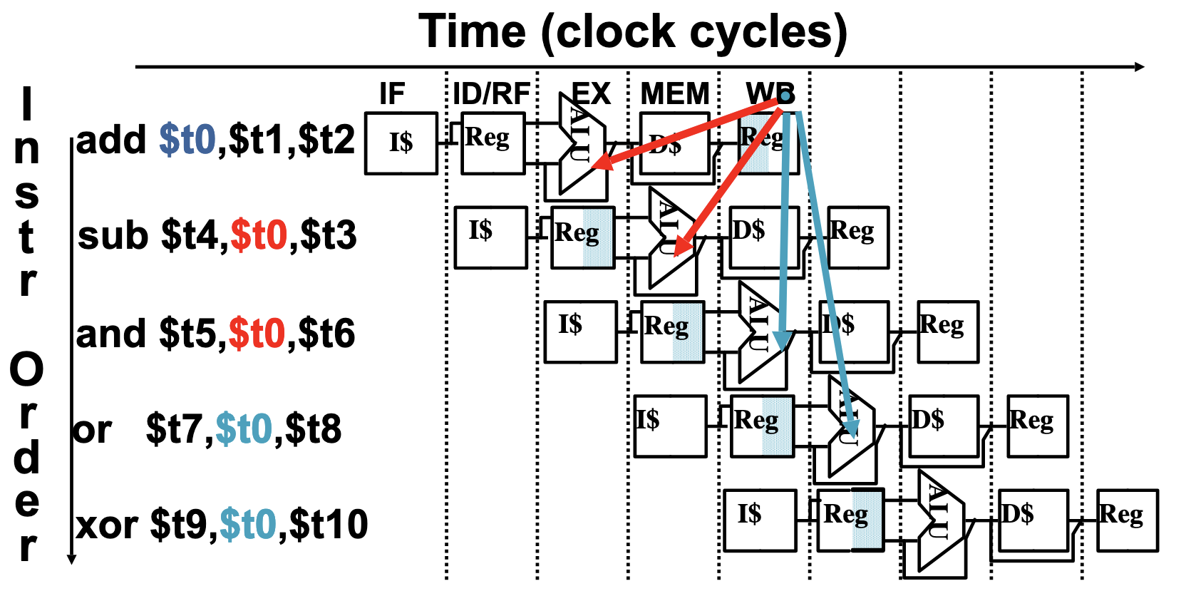
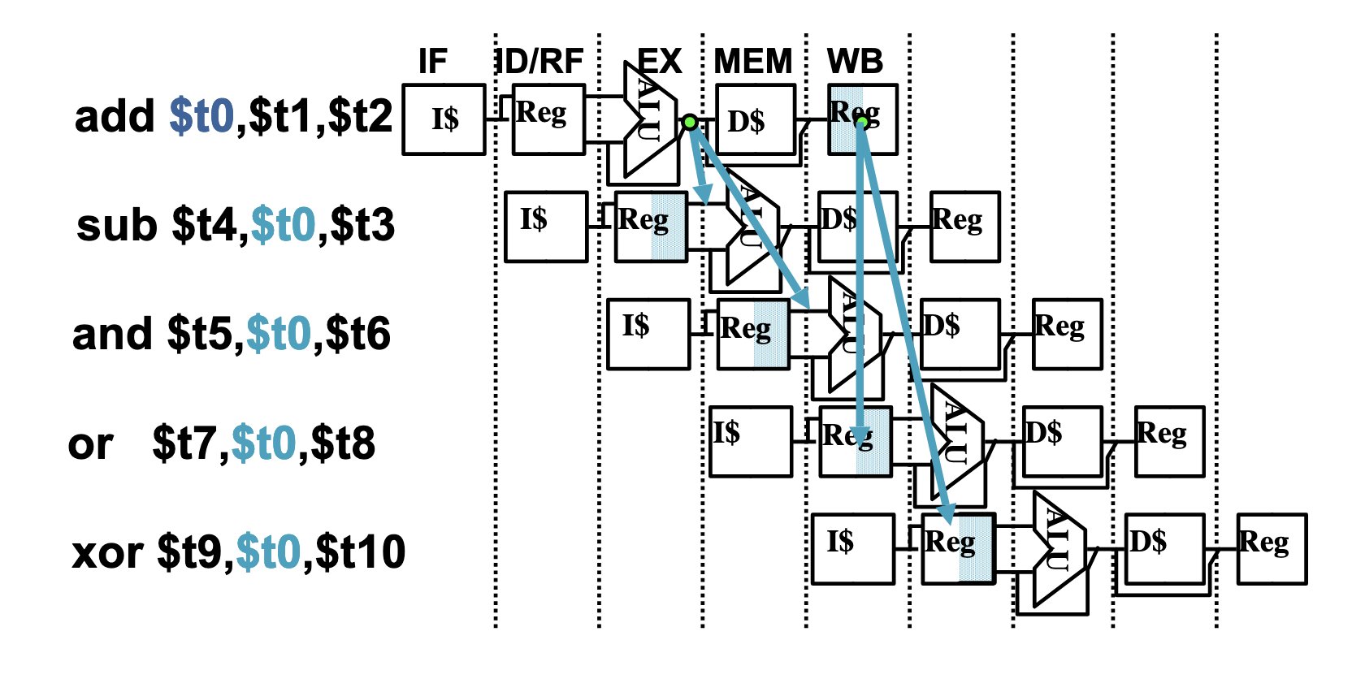
Visualizing Hazards

Slide 57
Exercise: Unresolveable Data Hazard
Question: Which instruction from the LC-2200 cannot be fully resolved even using data forwarding?
For this instruction, we would need to stall the pipeline to ensure correctness

Slide 58
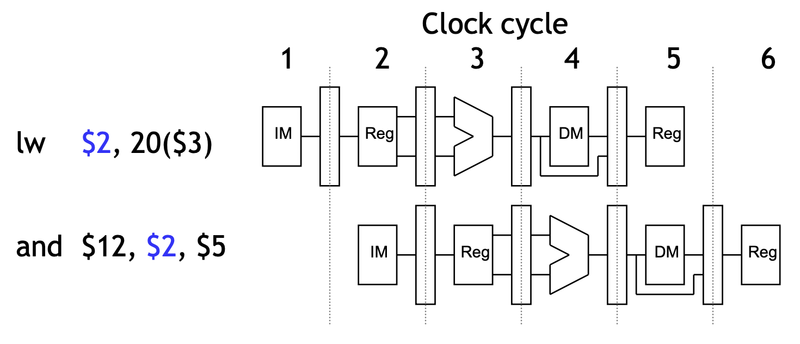
Unresolvable Data Hazard
Loads LW create an inevitable data hazard that cannot be forwarded. This is because data is not ready from the load when the next instruction is decoding.

Slide 59
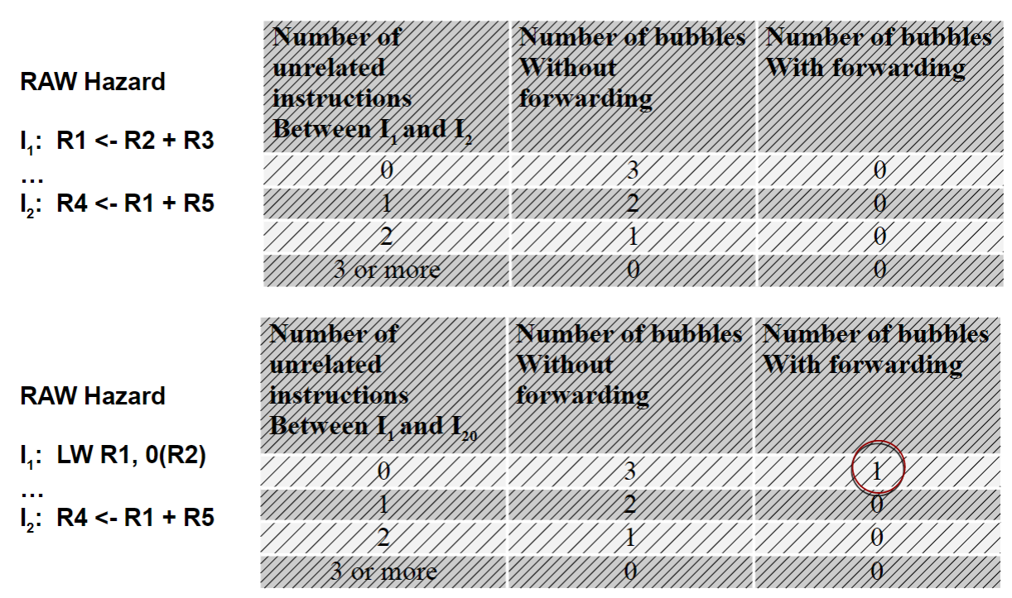
Pipeline Hazards Cheat Sheet

Slide 60
Control Hazards

Slide 61
Control Dependency
Question: What should the fetch PC be in the next cycle?
Answer: The address of the next instruction
The is very straightforward if the instruction we are considering is not a control-flow instruction. In this case, we just fetch the next address in memory.
How do we determine the next PC if we have a control-flow instruction?

Slide 62
Different types of BRANCH
type | direction at fetch time | potential next addresses | branch resolution
conditional | unknown | 2 | execute
unconditional | always taken | 1 | decode
call | always taken | 1 | decode
return | always taken | many | execute
indirect | always taken | many | execute

Slide 63
Static Branch Prediction
Predict Always Not Taken ~ not that good 30-40% accuracy
Predict Always Taken ~ 60-70% accuracy but we still need the address
Predict based off the target
targetPC > PC - if we are branching forwards, assume not taken (if statements)
targetPC < PC - if we are branching backwards, assume taken (loops)
BTFNT Backward Taken Forward Not Taken
These predictions work in tandem with the compiler, since if the compiler knows that a given branch will always be taken, it can place it before other branches.
If we are correct, we have saved clock cycles! What do we do if our prediction is wrong?
Answer: The pipeline now contains incorrect instructions that we need to use flushing to resolve

Slide 64
Exercise: Flushing the Pipeline
Question: Suppose that a BEQ instruction enters the pipeline and branch prediction is used to predict the path of the branch. If the prediction is wrong, which stages should we flush from the pipeline?
I4
I3
BEQ
I2
I1

Slide 65
Solution: Flushing the Pipeline
The result of the prediction is discovered once BEQ enters the EX stage
Therefore, all instructions before that stage (IF and ID/RR) need to be flushed so that the correct instructions can execute following the BEQ
The instructions in MEM and WB occur before BEQ, and thus should not be flushed
I4
I3
BEQ
I2
I1

Slide 66
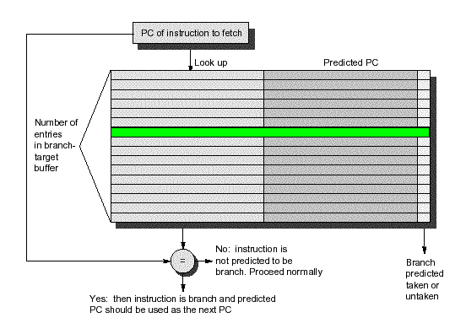
Branch Target Buffer
For each PC that is a branch, keep track of where we branched to last time the branch occurred.
Idea is that if a conditional resulted in a branch/no branch before, maybe it will result in the same way again
This is very useful for unconditional branches, such as jumps which will only ever branch to one address, and the branch is guaranteed.

Slide 67
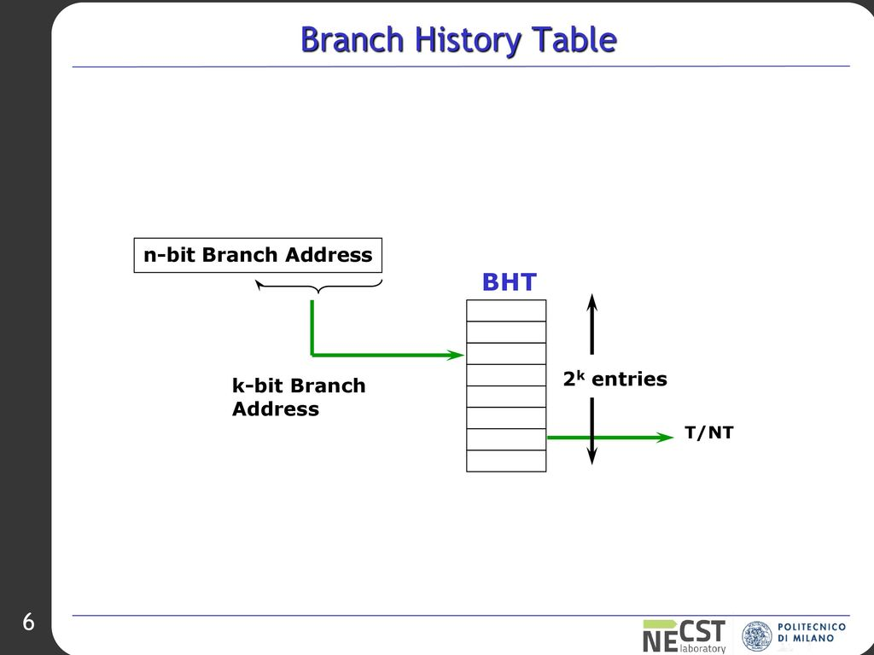
Additional: Branch History Table (Won’t Appear in Test)
Keep track of what happened to that branch the last time it occured in hardware, that can be indexed by the PC or by the branch history.
The table has 2^n entries if we index the first n bits of the PC.

Slide 68
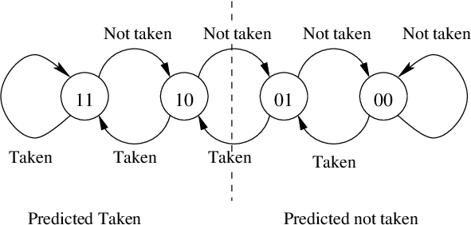
BTB Saturation Counters
Consider if we use two bits in BTB for keeping states.
When keeping track of the branches history, we can keep multiple bits of information, to say whether the branch is strongly or weakly taken / not taken.
This is important for branches that are only taken some of the time.

Slide 69
Branch Prediction Example
Branch Target Buffer
State | Prediction
00 | 0 (Strongly NT)
01 | 0 (Weakly NT)
10 | 1 (Weakly T)
11 | 1 (Strongly T)
0x00: addi, $t0, $zero, 0
0x01: addi, $t1, $zero, 10
loop_label:
0x02: nop
. . .
0x10: addi $t0, $t0, 1
0x11: blt $t0, $t1, loop_label
BTB Entry for Inst 0x11 Target 0x02
Iteration | 0 | 1 | 2 | ... | 9 | 10
State | 01
Predict | Guess NT
Actual | T

Slide 70
Branch Prediction Example
Branch Target Buffer
State | Prediction
00 | 0 (Strongly NT)
01 | 0 (Weakly NT)
10 | 1 (Weakly T)
11 | 1 (Strongly T)
0x00: addi, $t0, $zero, 0
0x01: addi, $t1, $zero, 10
loop_label:
0x02: nop
. . .
0x10: addi $t0, $t0, 1
0x11: blt $t0, $t1, loop_label
BTB Entry for Inst 0x11 Target 0x02
Iteration | 0 | 1 | 2 | ... | 9 | 10
State | 01 | 10 | 11 | 11 | 11 | 11
Predict | Guess NT | T | T | T | T | T
Actual | T | T | T | T | T | NT
We guess it wrong twice but we get it right 9 times!!

Slide 71
Project 2 Questions???

Slide 72
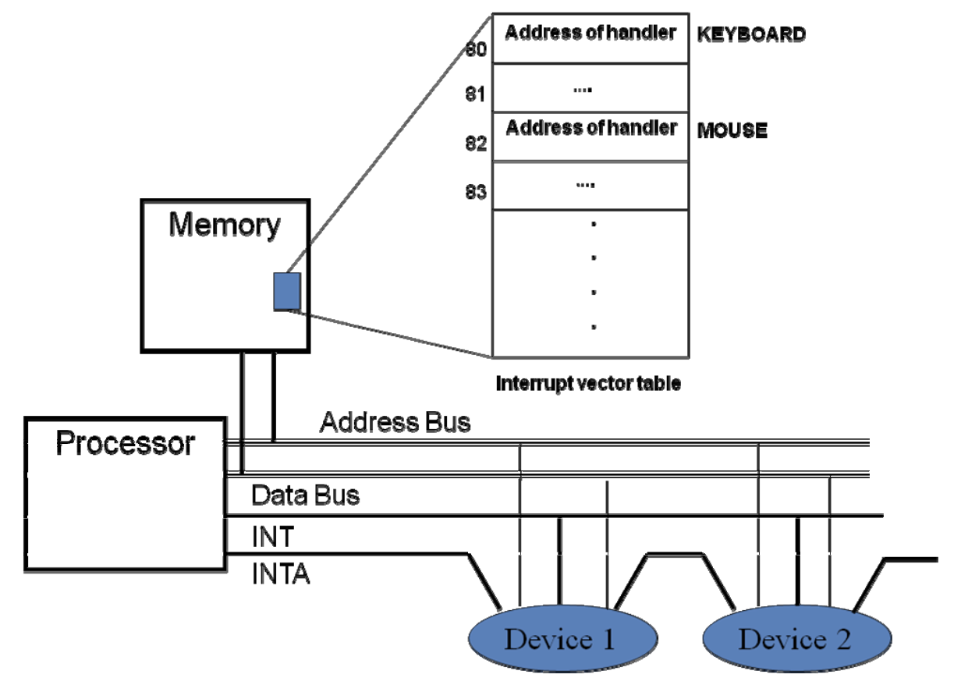

Slide 73
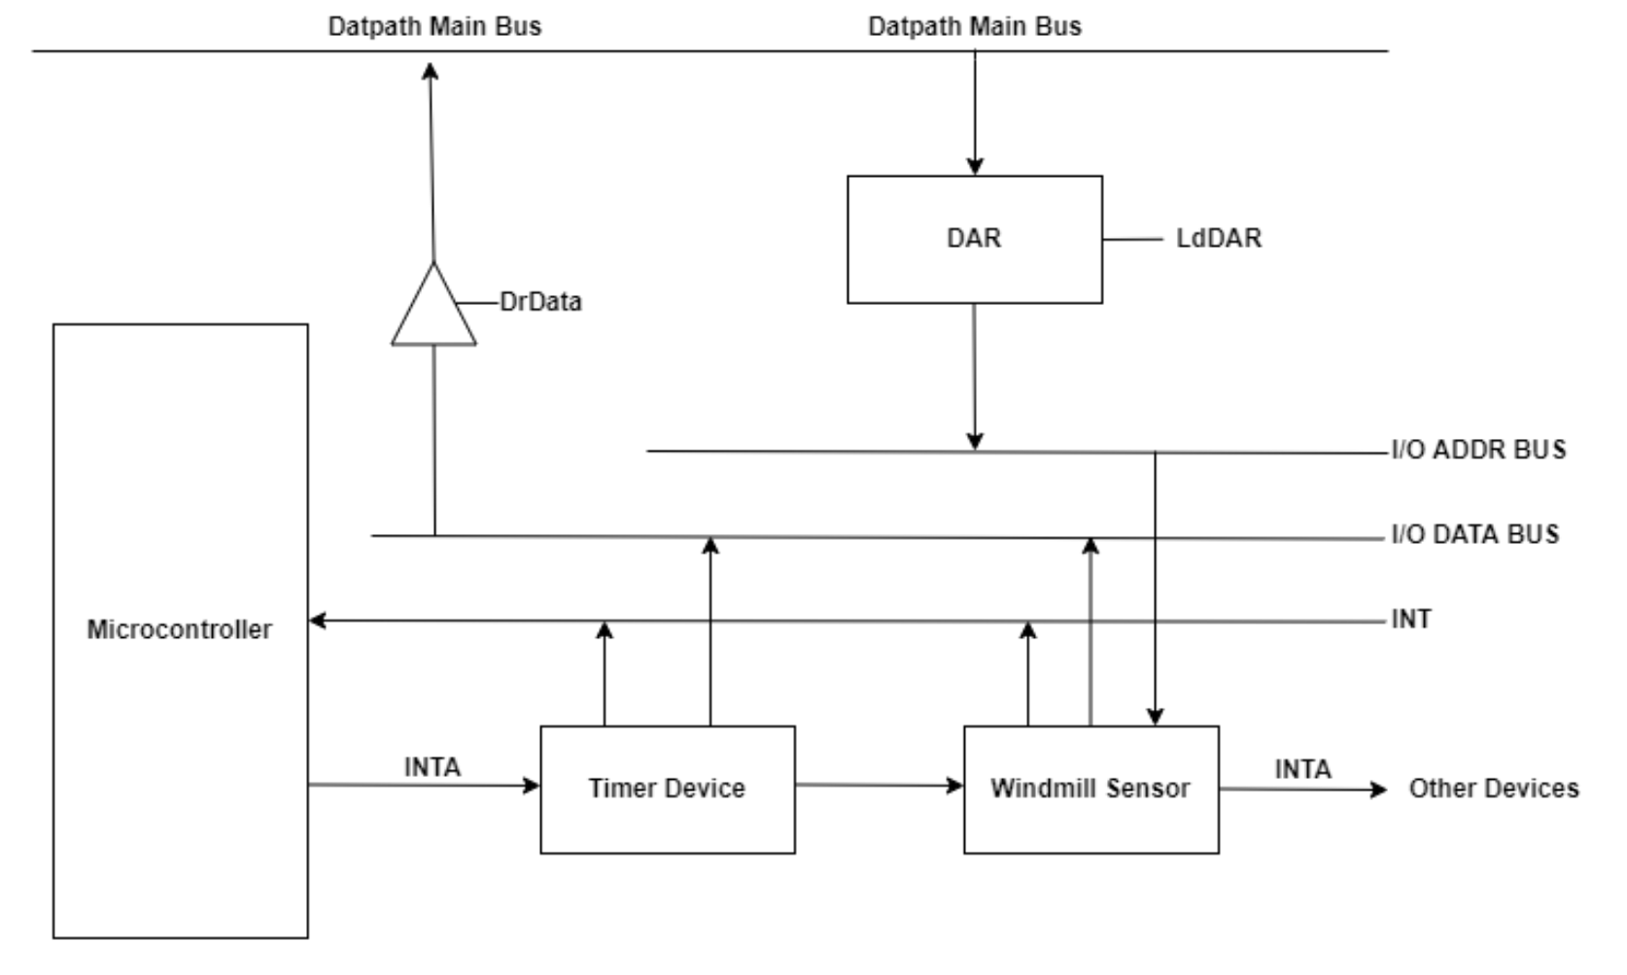

Slide 74
Thanks for Attending :)

Slide 75
Revision Notes

